Slide 1
Database Design and Implementation
Lecture 1
Introduction to Database Design

Slide 2
Learning Outcomes
In this Lecture, you will learn:
  That successful database design must reflect the information system of which the database is a part
  That successful information systems are developed within a framework known as the Systems Development Life Cycle (SDLC)
  That within the information system, the most successful databases are subject to frequent evaluation and revision within a framework known as the Database Life Cycle (DBLC)
  How to conduct evaluation and revision within the SDLC and DBLC frameworks
  About database design strategies: top-down vs. bottom-up design

Slide 3
Agenda
This Lecture will cover:
  The Information System
  Systems Development Life Cycle
  Database Life Cycle
  Database Design
  Approaches to Database Design
  Database Design Process
  Database Implementation
Notes:
NCC Education - Slide Master

Slide 4
The Information System
Provides for data collection, storage, and retrieval
Composed of:
  People, hardware, software
  Database(s), application programs, procedures
Systems analysis: Process that establishes need for and extent of information system
Systems development: Process of creating information system

Slide 5
Performance Factors of an Information System
Database design and implementation
Application design and implementation
Administrative procedures
Database development: Process of database design and its implementation

Slide 6
Systems Development Life Cycle (SDLC)
Traces history of an information system
Provides a picture within which database design and application development are mapped out and evaluated
Iterative rather than sequential process

Slide 7
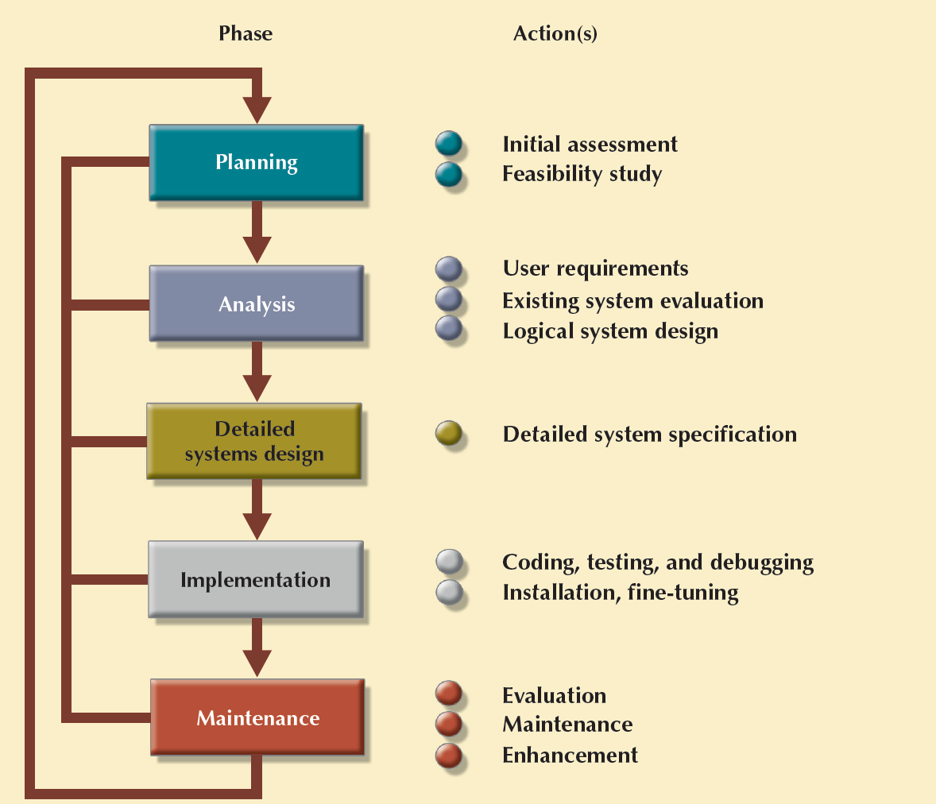
Systems Development Life Cycle (SDLC)
Cengage Learning © 2015

Slide 8
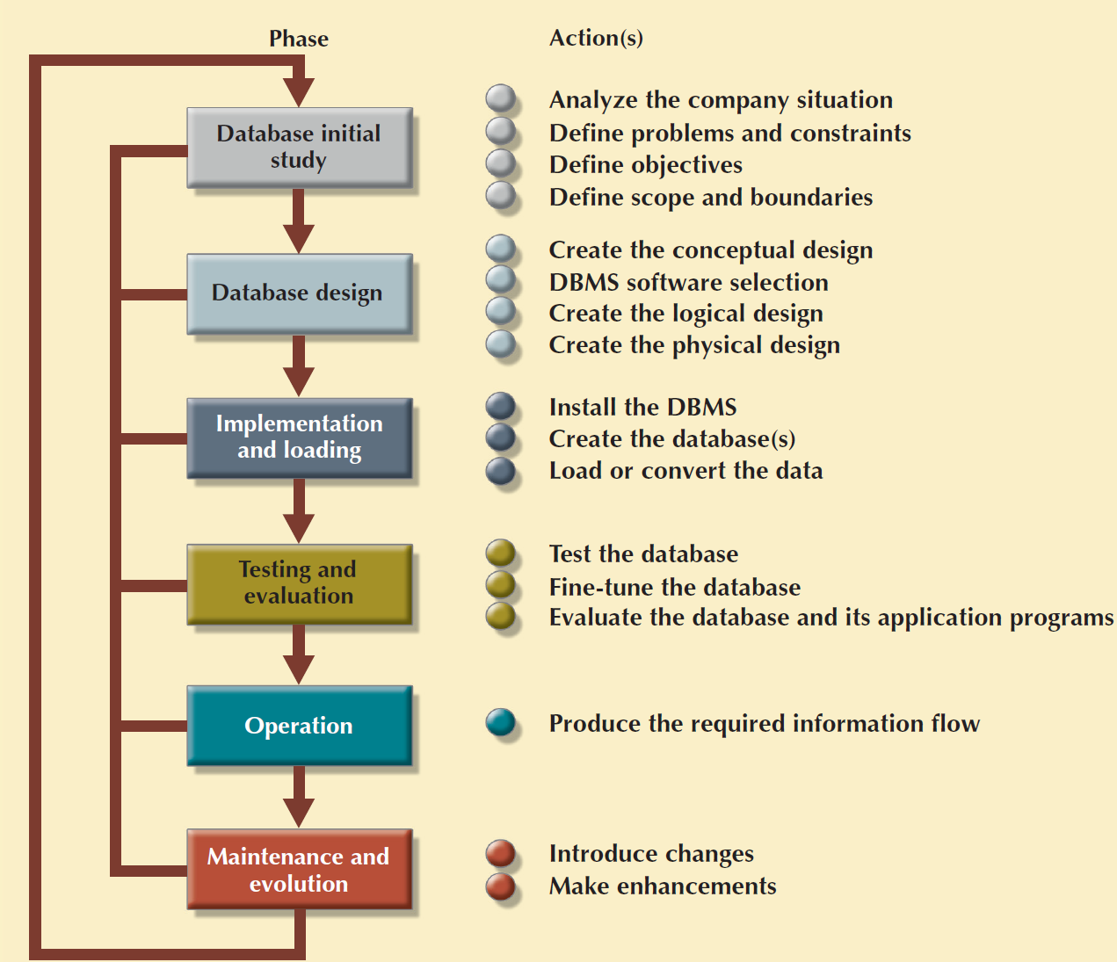
The Database Life Cycle (DBLC)
Cengage Learning © 2015

Slide 9
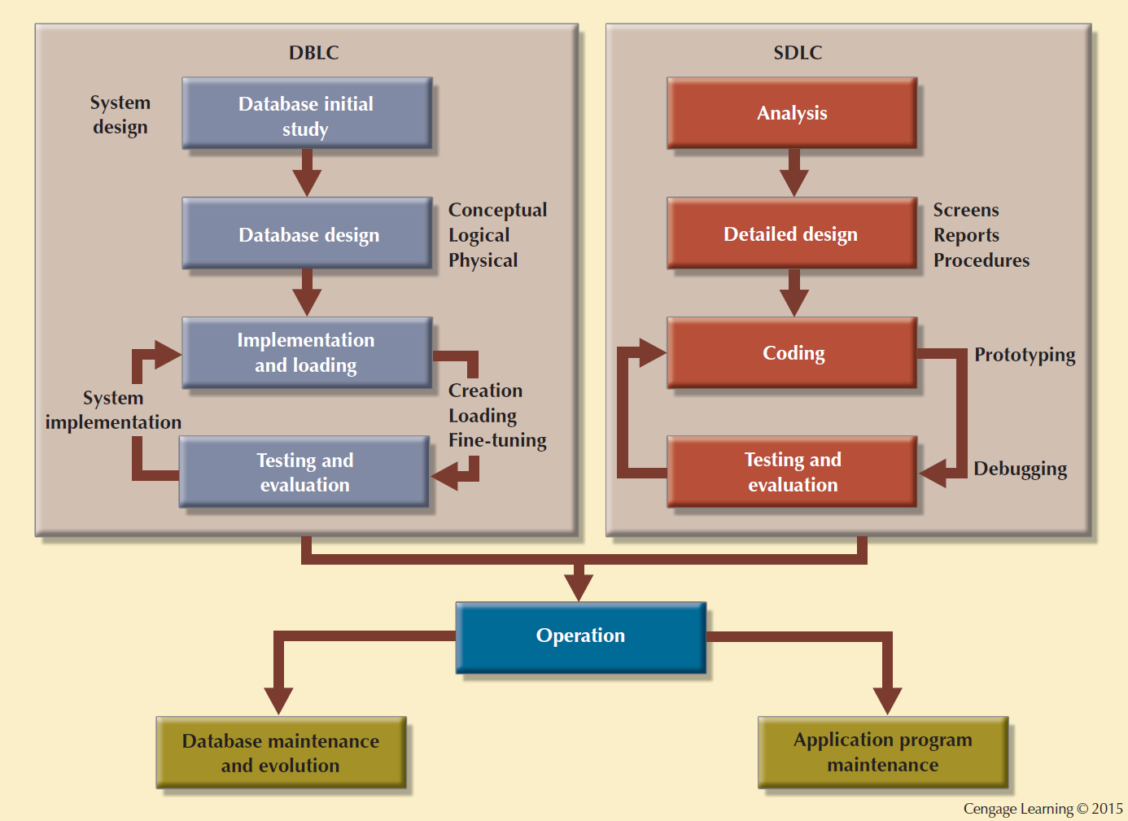
Parallel Activities in the DBLC and the SDLC

Slide 10


Slide 11
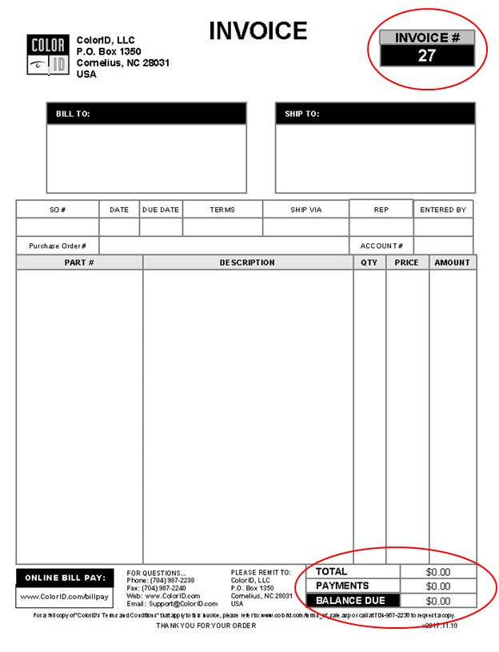

Slide 12
Database Design
The process of creating a design that will support the enterprise’s mission statement and mission objectives for the required database system
Supports company’s operations and objectives
Checks the ultimate final product from all perspectives
Pointers for examining completion procedures
  Data component is an element of whole system
  System analysts/programmers design procedures to convert data into information
  Database design is an iterative process

Slide 13
Approaches to Database Design
Bottom-up
  Begins at the fundamental level of attributes
    Entities
    Relationships
  Appropriate for the design of simple databases with a relatively small number of attributes
  Top-down
    starts with the development of data model
    applies successive top-down refinements to identify lower-level entities, relationships, and the associated attributes
    illustrated using the concepts of the Entity-Relationship (ER) model

Slide 14
Database Design Process
Conceptual
Design
Data analysis and requirements
Entity Relationship modeling and normalization
Data model verification
Distributed database design
DBMS
Selection
Select the DBMS
Logical
Design
Map conceptual model to logical model components
Validate logical model using normalization
Validate logical model integrity constraints
Validate logical model against user requirements
Physical
Design
Define data storage organization
Define integrity and security measures
Determine performance measures

Slide 15
Phases of Database Design
Conceptual database design
Logical database design
Physical database design

Slide 16


Slide 17
Conceptual Design
Designs a database independent of database software and physical details
Conceptual data model - Describes main data entities, attributes, relationships, and constrains
Designed as software and hardware independent
Minimum data rule: All that is needed is there, and all that is there is needed

Slide 18
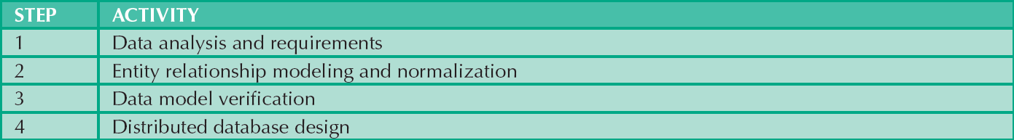
Conceptual Design Steps
Cengage Learning © 2015

Slide 19
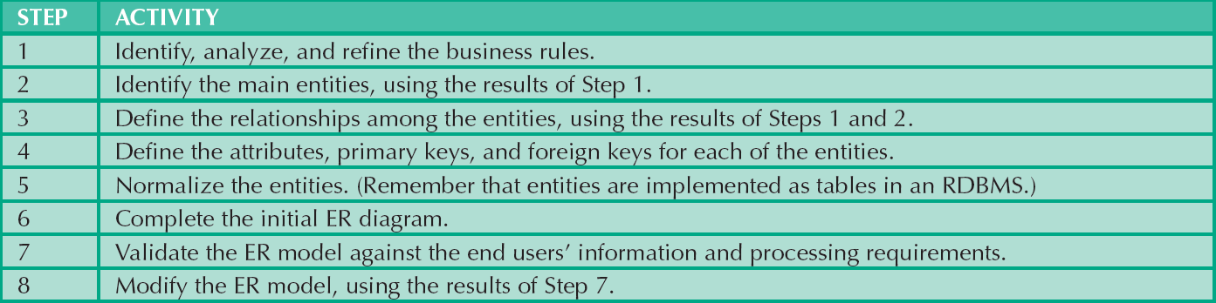
Developing the Conceptual Model Using ER Diagrams
Cengage Learning © 2015

Slide 20
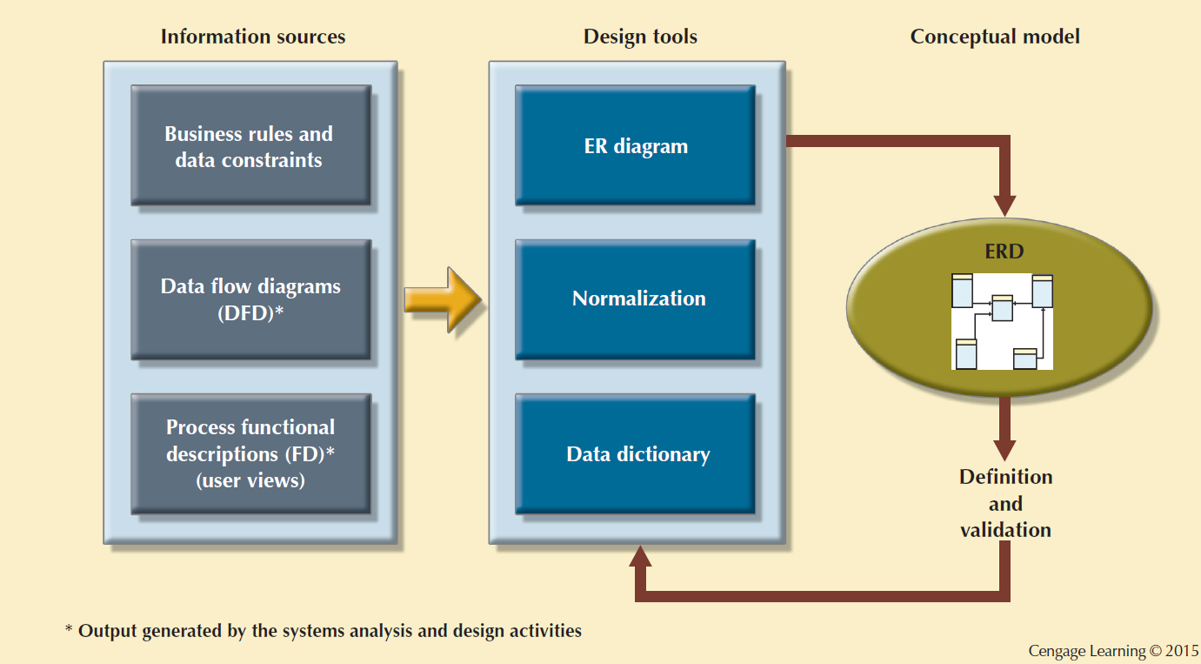
Conceptual Design Tools and Information Sources

Slide 21
Logical database design
  The process of constructing a model of the data used in an enterprise based on a specific data model, but independent of a particular DBMS and other physical considerations
  Based on the target data model for the database (for example, the relational data model)
  Any other aspects of the chosen DBMS and, in particular, any physical details, such as storage structures or indexes are ignored

Slide 22

Logical Design Steps
Cengage Learning © 2015

Slide 23

Mapping the Conceptual Model to the Relational Model
Cengage Learning © 2015

Slide 24
Difference between Conceptual and Logical Design
  Conceptual design is independent of data model and target DBMS
  Logical model takes account of data model (but not DBMS)
  Thus in logical design we know we are dealing with, for example, a relational model

Slide 25
Physical database design
  The process of producing a description of the implementation of the database on secondary storage; it describes the base relations, file organizations, and indexes used to achieve efficient access to the data, and any associated integrity constraints and security measures
  Physical design is tailored to a specific DBMS system
  For the relational model
      creating a set of relational tables and the constraints
      identifying the specific storage structures and access methods for the data
      designing security protection for the system

Slide 26

Physical Design Steps
Cengage Learning © 2015

Slide 27
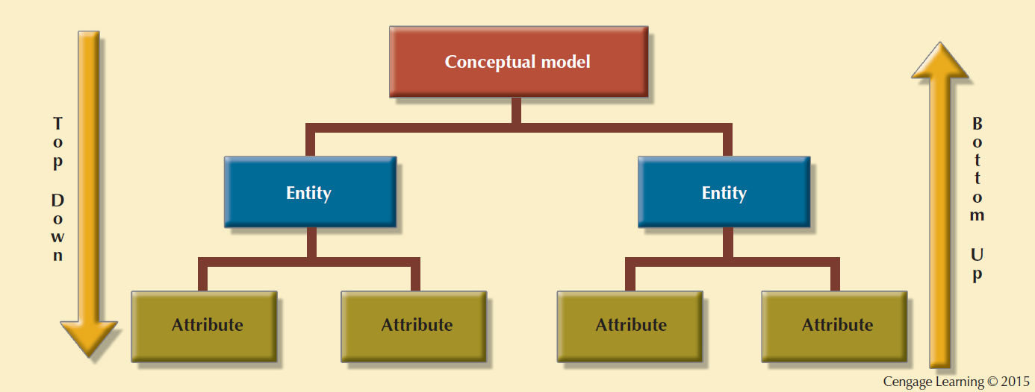
Top-down vs. Bottom-up Design Sequencing

Slide 28
Database Implementation
The physical realization of the database and application designs
On completion of the design stages, implement the database and the application programs
Database implementation is achieved using the DDL of the selected DBMS or a GUI
The DDL statements are used to create the database structures and empty database files

Slide 29
References
Database Systems: Design, Implementation, and Management by Carlos Coronel and Steven Morris,13th Edition, Cengage, Chapter 9.
Database Systems A Practical Approach to Design, Implementation and Management by Thomas Connolly and Carolyn Begg, Sixth Edition, Pearson, Chapter 10

